Slide 1


Introduction to Python
Noble Xavier

Slide 2
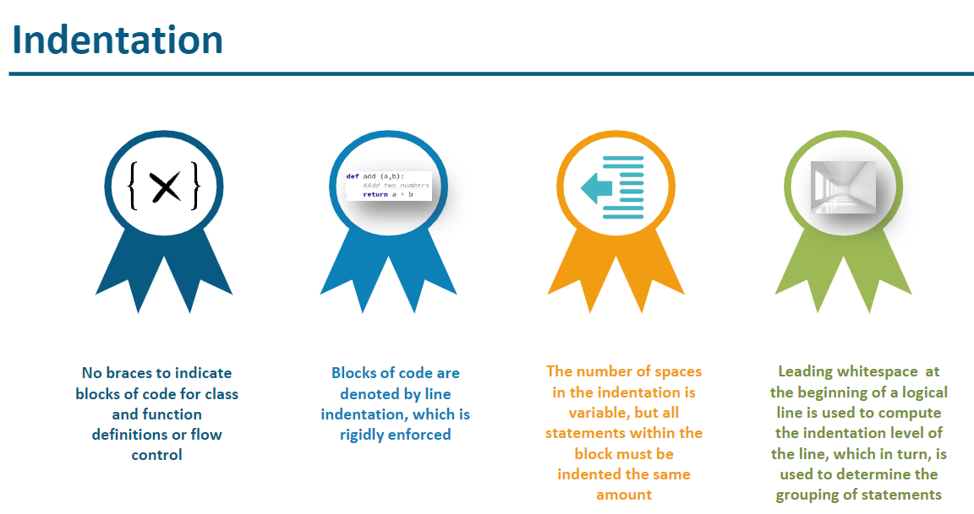

Slide 3
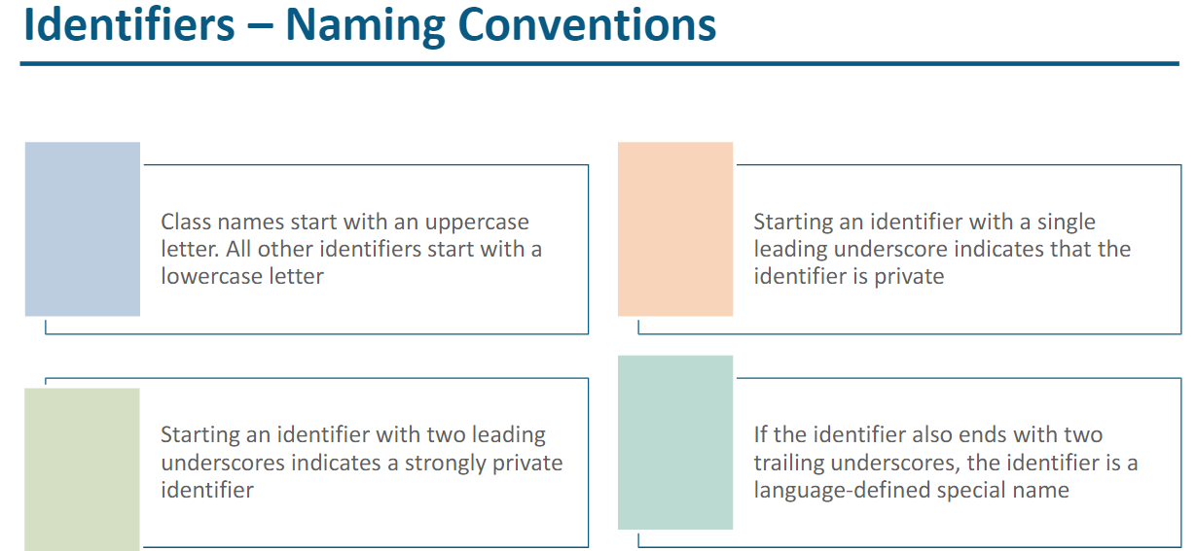

Slide 4
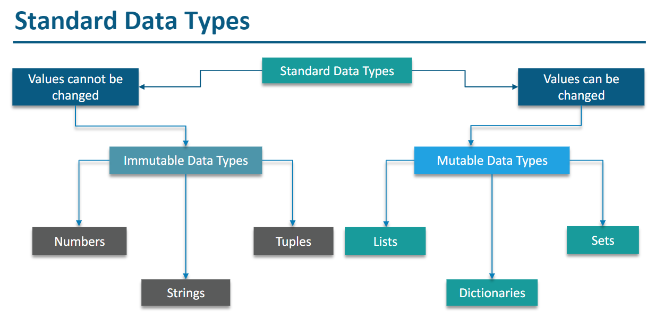

Slide 5
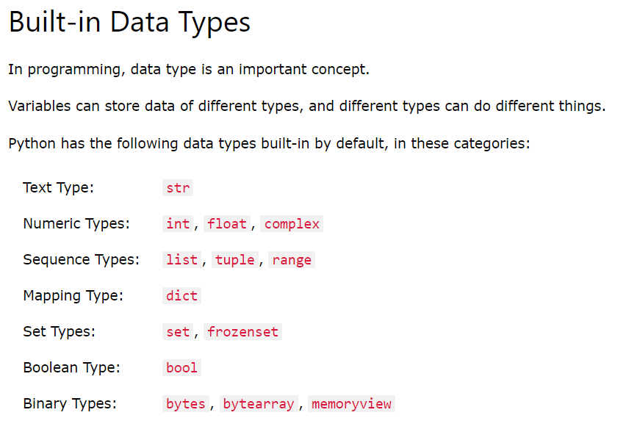

Slide 6
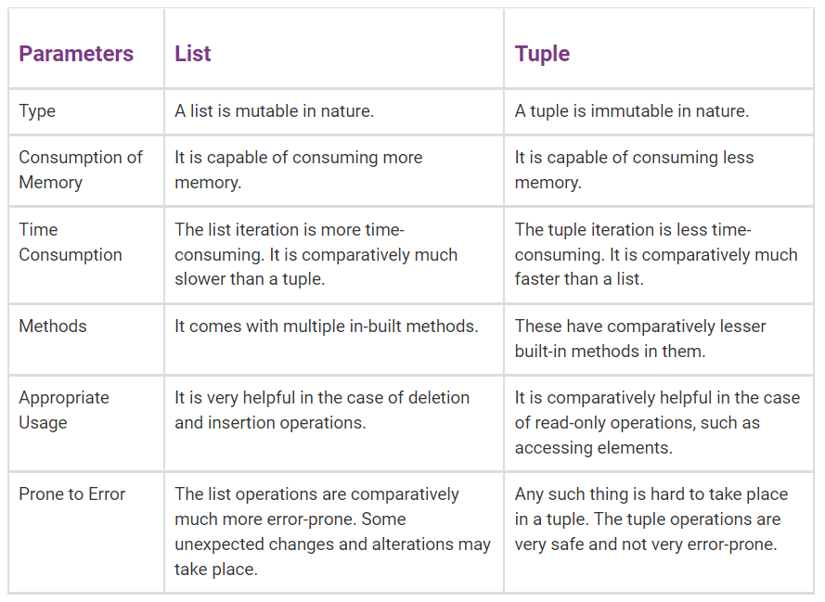
Difference Between List and Tuple in Python

Slide 7
Difference Between List and Tuple in Python
Operations
Although there are many operations similar to both lists and tuples, lists have additional functionalities that are not available with tuples. These are insert and pop operations, and sorting and removing elements in the list.
Size
In Python, tuples are allocated large blocks of memory with lower overhead, since they are immutable; whereas for lists, small memory blocks are allocated. Between the two, tuples have smaller memory. This helps in making tuples faster than lists when there are a large number of elements.

Slide 8
Difference Between List and Tuple in Python
Length
Lengths differ in the two data structures. Tuples have a fixed length, while lists have variable lengths. Thus, the size of created lists can be changed, but that is not the case for tuples.
Debugging
When it comes to debugging, in lists vs tuples, tuples are easier to debug for large projects due to its immutability. So, if there is a smaller project or a lesser amount of data, it is better to use lists. This is because lists can be changed, while tuples cannot, making tuples easier to track.

Slide 9
bytes, bytearray, memoryview
It can store Values from 0 to 255
bytes and bytearray are used for manipulating binary data. The memoryview uses the buffer protocol to access the memory of other binary objects without needing to make a copy.
Bytes objects are immutable sequences of single bytes. We should use them only when working with ASCII compatible data.
The syntax for bytes literals is same as string literals, except that a 'b' prefix is added.
bytearray objects are always created by calling the constructor bytearray(). These are mutable objects.

Slide 10
bytes, bytearray, memoryview
Bytes
It can store Values from 0 to 255
example -1
b1= bytes ([10,20,30,255])
print (b1) # Print Bytes
for i in b1:
print (i)
example -2- Error – since value more than 255
b1= bytes ([10,20,30,300])
print (b1) # Print Bytes

Slide 11
bytes, bytearray, memoryview
Bytes
It is immutable - Item assignment not possible
example -1 – This is not possible since immutable
b1[1] =25

Slide 12
bytes, bytearray, memoryview
Bytearray
It is mutable - Item assignment possible
example -1
b1= bytearray([10,20,30,255])
print (b1)
b1[1]=100 # update first element with 100
for i in b1:
print (i)

Slide 13
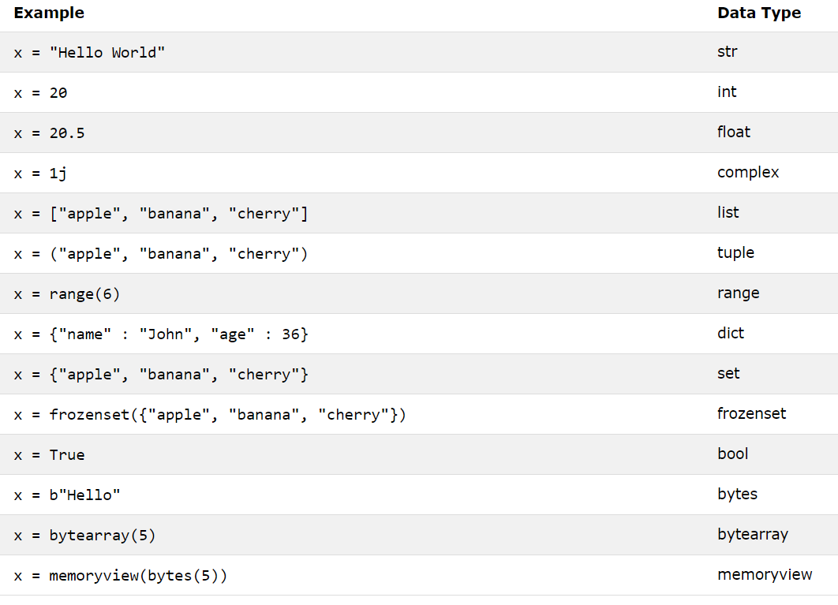

Slide 14
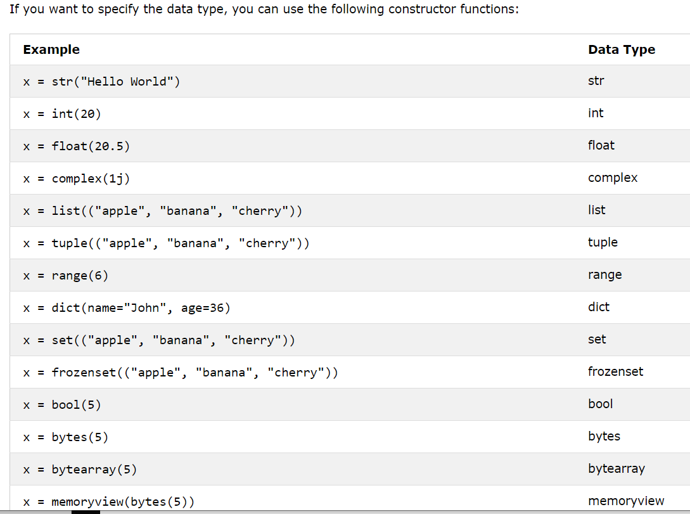

Slide 15
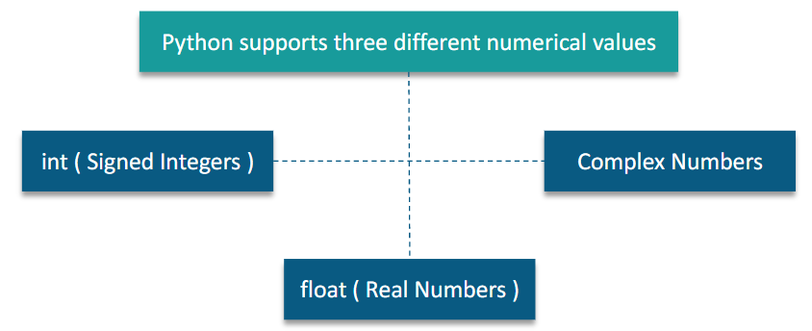

Slide 16
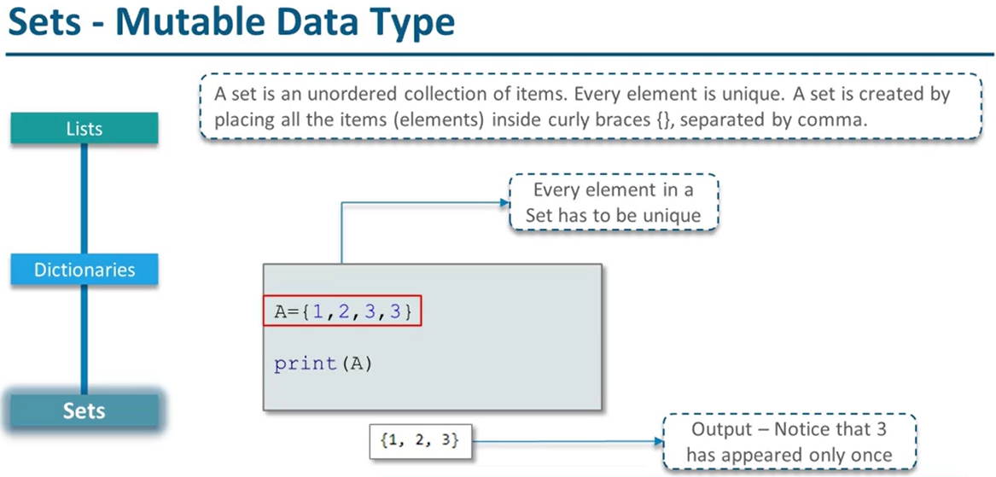

Slide 17
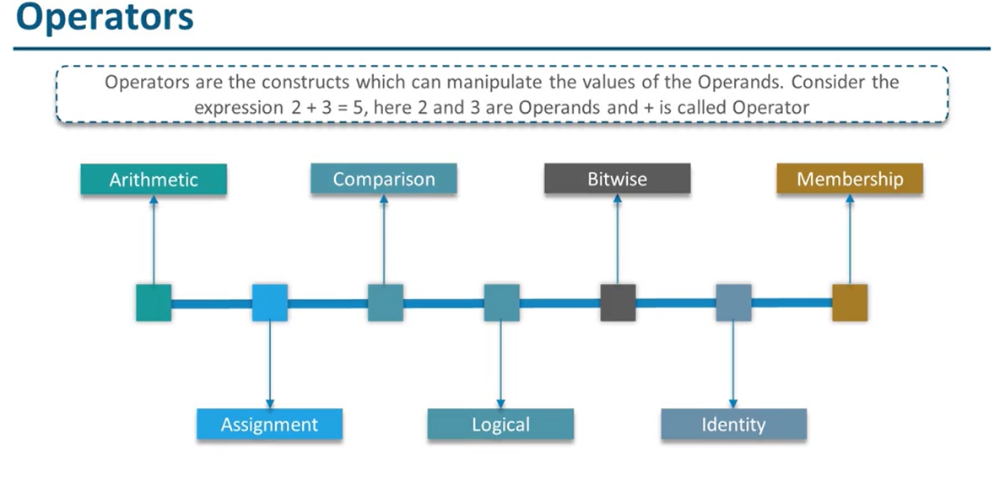

Slide 18
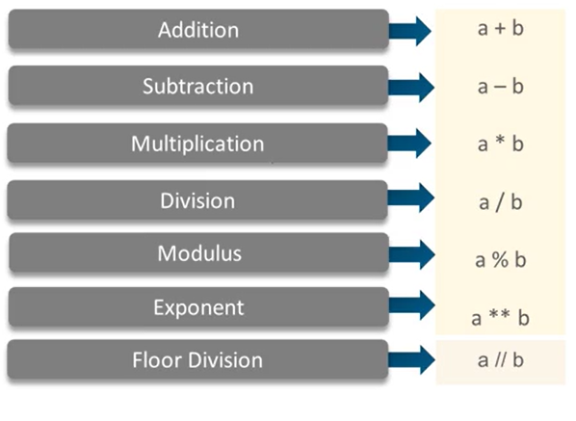
Arithmetic Operator

Slide 19
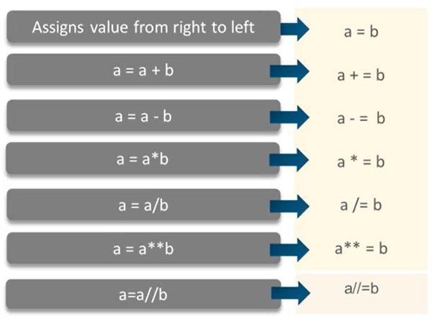
Assignment Operator

Slide 20
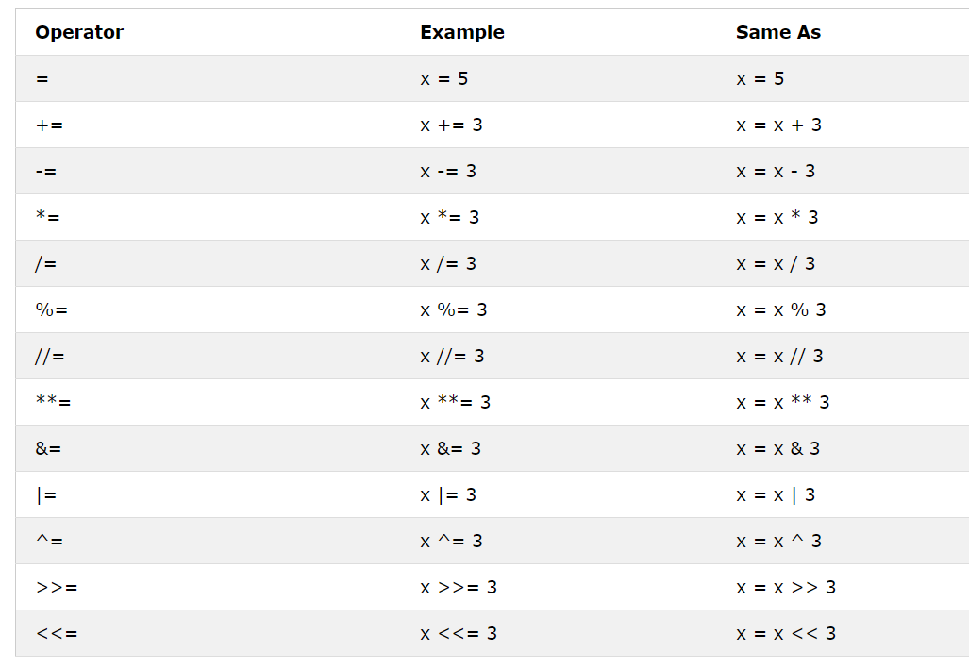

Slide 21
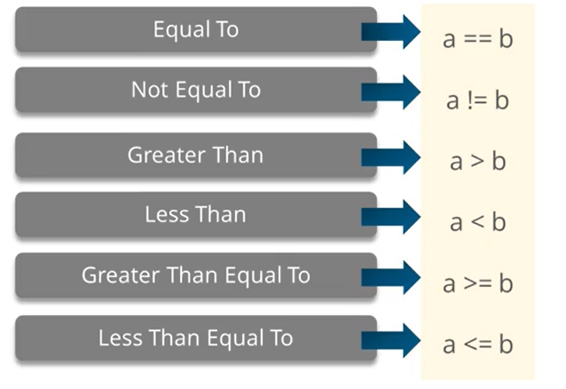
Comparison True / False

Slide 22
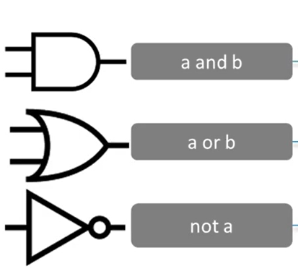
Logical Operator

Slide 23
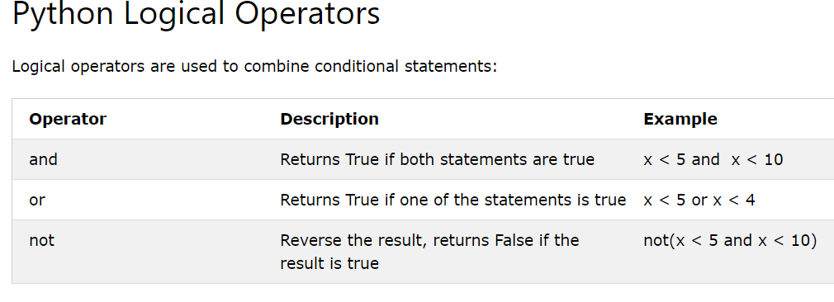

Slide 24
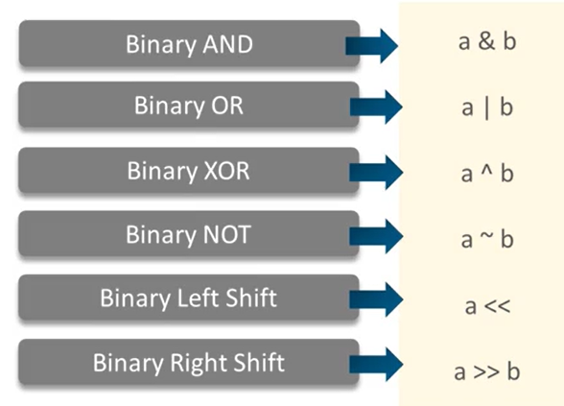
Bitwise -Operator

Slide 25
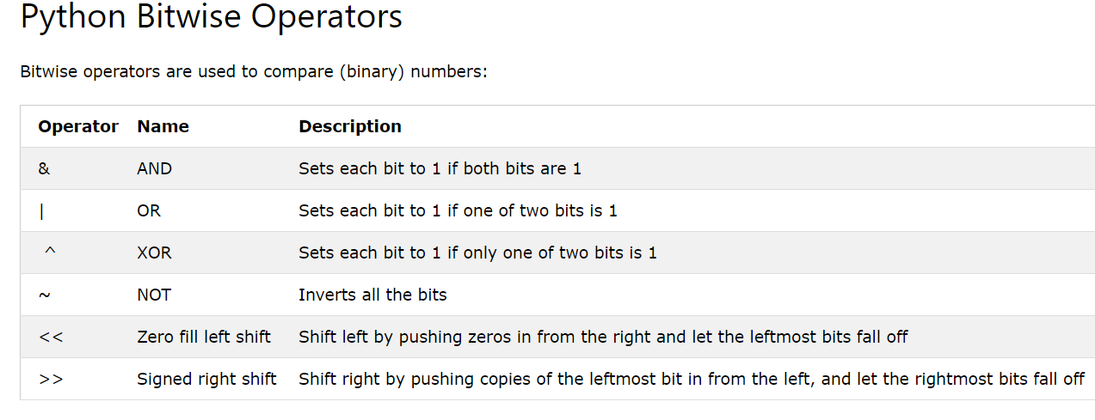

Slide 26
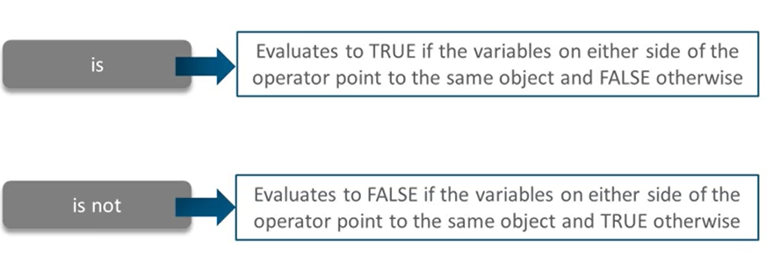
Identity Operator

Slide 27
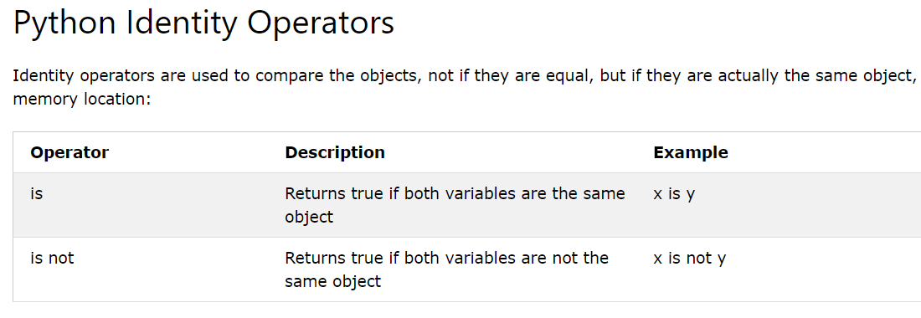

Slide 28
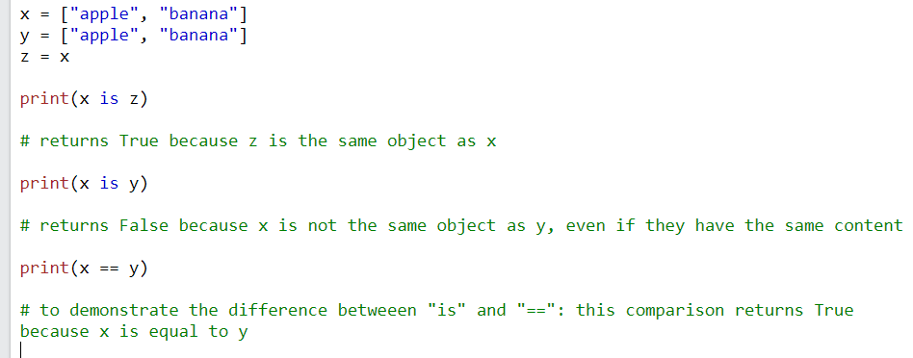
x = ["apple", "banana"]
y = ["apple", "banana"]
z = x
print(x is z)
print(x is y)
print(x == y)

Slide 29
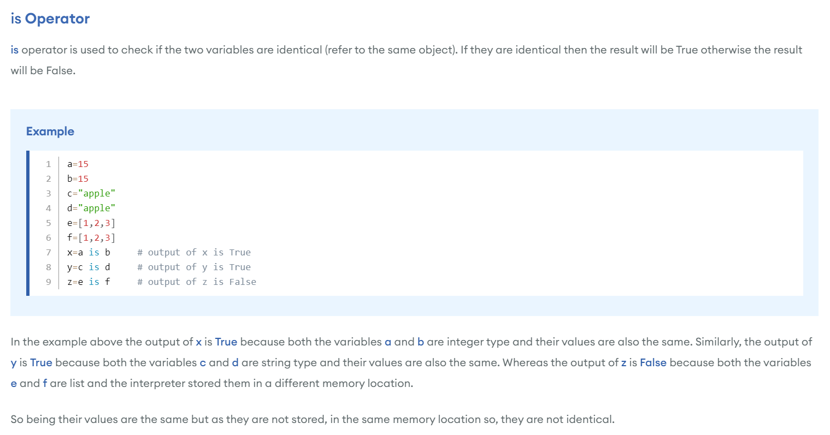

Slide 30
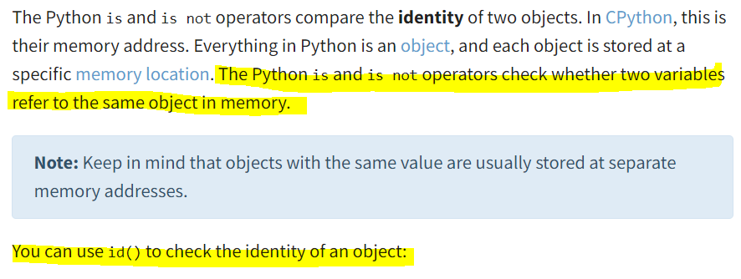
a = 50
b = 50
c= a
print (id(a))
print (id(b))
print (id(c))
print (a is b)
print (c is a)
print (c is b)
a = 500
b = 500
c= a
print (id(a))
print (id(b))
print (id(c))
print (a is b)
print (c is a)
print (c is b)

Slide 31
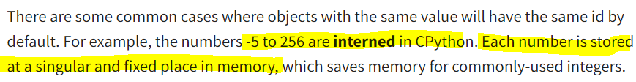
a = 256
b = 256
print (a is b)
print ( id(a))
print ( id(b))
when their values are outside the range of common integers (ranging from -5 to 256), they’re stored at separate memory addresses.
a = 257
b = 257
print (a is b)
print ( id(a))
print ( id(b))

Slide 32
Append
Copy- Different Location
a = [1, 2, 3]
b = a
print (a)
print (id(a))
print (b)
print (id(b))
print ()
print (a is b)
print ('*****Append****')
print ()
a.append(4)
print (a)
print (id(a))
print (b)
print (id(b))
print (a is b)
a = [1, 2, 3]
b = a.copy()
print (a)
print (id(a))
print (b)
print (id(b))
print ()
print (a is b)
print ('*****Append****')
print ()
a.append(4)
print (a)
print (id(a))
print (b)
print (id(b))
print (a is b)

Slide 33
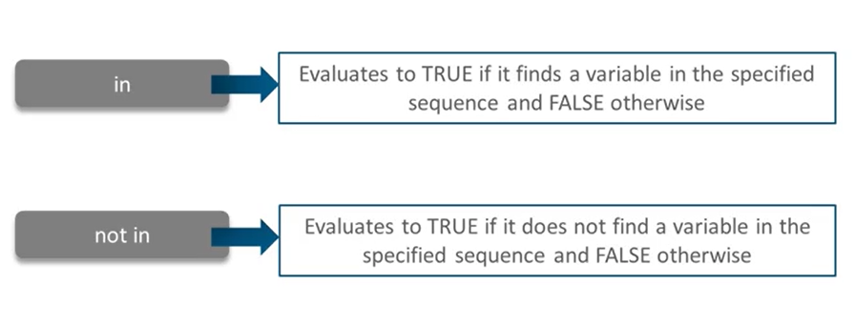
Member ship
A = [10,15,20]
print (15 in A)
A = [10,15,20]
print (15 in A)

Slide 34
